Slide 1

WWARMING UP

Slide 2
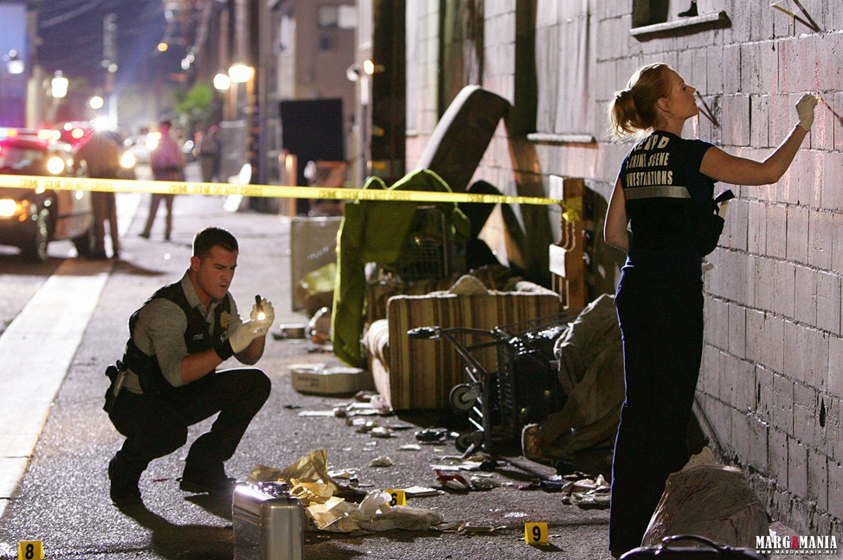
The theme: ???

Slide 3
The theme:
The Crime Report

Slide 4

OBJECTIVE:
Using the crime vocabulary, working individually and in pairs, you will make up a story and write down the text of 1-5 sentences on the topic “The Crime Report” and self-assess yourselves (developing the competences)

Slide 5

ASSESSMENT: I can assess my results!
Task 1: I know the meaning of the crime words doing the Kahoot quiz –
1-14 points
Task 2: I can guess and write the crime words - 1-8 points
Task 3: I can understand the news reports during listening – 1 – 5 points
Task 4: I can make up the news report consisting of 1-5 sentences and write it 1-5 points
I am active at the lesson – 1-2 points

Slide 6
ASSESSMENT: I can assess my results!
At the end you will be able to have 14-34 points
POINTS | MARK
32-34 | 10
29-31 | 9
26-28 | 8
23-25 | 7
20-22 | 6
17-19 | 5
14-16 | 4

Slide 7

Task 1: The Kahoot Quiz on Crime (10 min)
Working individually
and using your smartphones you can join the Kahoot quiz and check your vocabulary on crimes

Slide 8

Task 2: Speaking on Crime Scene (10 min)
Working in pairs
You need to explain the words for your neighbour to guess.
“What’s number 4?”
When your classmate guesses your word, your he / she writes them into the grid.
Criteria of evaluation
You get 1 point for each word that you guessed and wrote in the crossword.
LET’S SET THE TIME

Slide 9
Task 3: Listening to the news reports (5 min)
Working individually
You have to listen to 5 news reports about crime scenes, identify the crimes and write down them in the worksheet.
Criteria of evaluation
You get 1 point for each word that you identified correctly.

Slide 10
Task 3: Listening to the news reports (5 min)
Let’s check the answers:
1 theft
2 mugging
3 drug dealing
4 vandalism
5 shoplifting
Criteria of evaluation
You get 1 point for each word that you identified correctly.

Slide 11


Using the learnt crime vocabulary, working individually and in pairs, you will make up a story and write down the text of 1-5 sentences on the topic “The Crime Report” and self-assess yourselves.

Slide 12
Task 4 (8 min): Making up a story
Working in pairs, make a story using the words on the squares and giving information on the following:
• What the crime was
• Where and when it happened
• Who did it and why
• How the police tried to solve the crime
• What happened to criminals
LET’S SET THE TIME

Slide 13
Task 4 (8 min): Making up a story
Working in pairs, make a story using the words on the cards and giving information on the following:
Criteria of evaluation
5 sentences - 5 points
4 sentences – 4 points
3 sentences – 3 points
2 sentences – 2 points
1 sentence – 1 point
LET’S SET THE TIME

Slide 14
ASSESSMENT: I can assess my results!
☺ At the end of the lesson let’s count your total points for doing all the tasks:
POINTS | MARK
32-34 | 10
29-31 | 9
26-28 | 8
23-25 | 7
20-22 | 6
17-19 | 5
14-16 | 4

Slide 15


Evaluation: I can evaluate my work and my feelings! Take your phones and go to menti.com use code: 8102 7437
How are you assessing yourself at the end of the lesson?
- I can do it without mistakes and help others
- I can do it by myself
- Sometimes I need help
- I can't do it by myself

